Slide 1
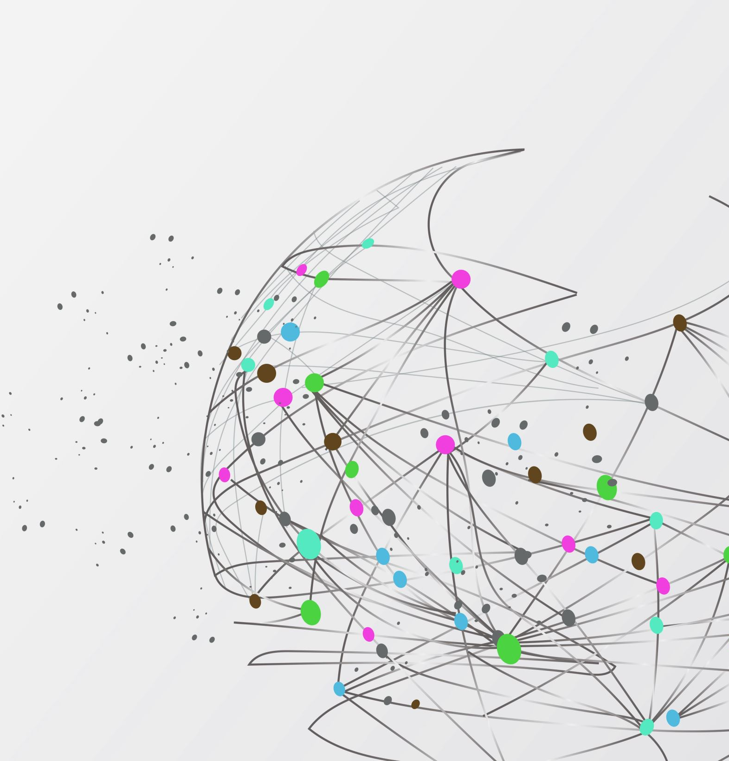
NEREDE YESEK?
A comprehensive Web GIS application developed for restaurant discovery, social interaction, and group decision-making.
Necip Orkun YALÇIN

Slide 2
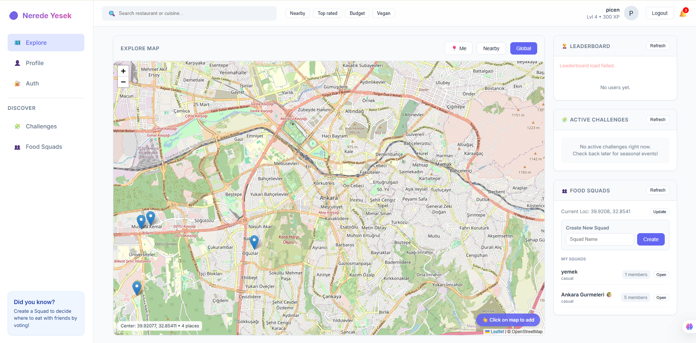

Slide 3
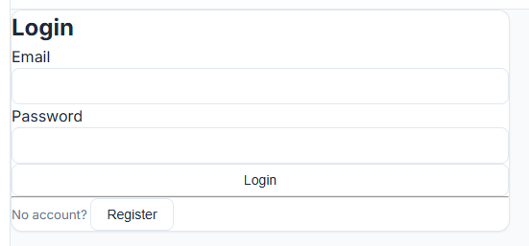
The application secures user data by utilizing JWT for authentication and Bcrypt for password hashing.

Slide 4
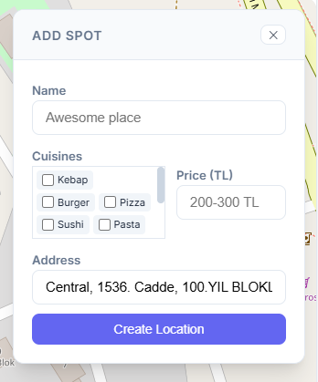
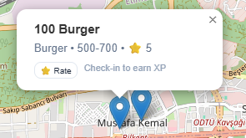
Users can contribute spatial data by creating new spots on the map and rate these locations through the check-in system.

Slide 5
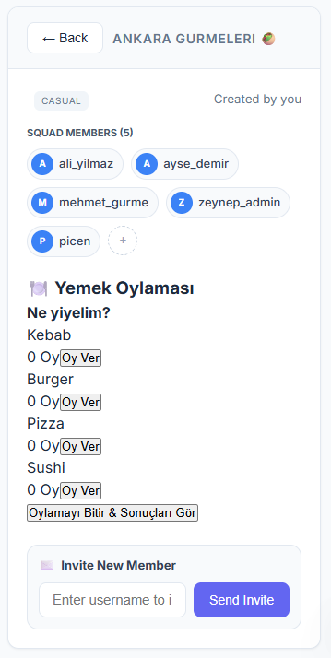
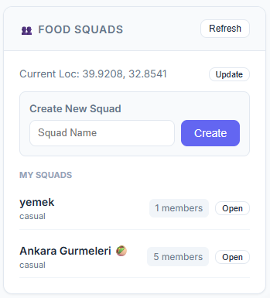
Users can form new squads to make collective dining decisions and initiate live voting sessions for restaurants within these groups.

Slide 6
THANK YOU FOR LİSTENİNG.

